Slide 1

Handwriting Gesture Detection and Recognition
- Malhar Mahant
- Kruthika Gangaraju - Sriram Kodeeswaran

Slide 2

PROBLEM STATEMENT
Handwritten text recognition is a challenging task due to variations in handwriting styles, shapes, and quality. The main objective of this project is to develop an accurate and efficient system for recognizing handwritten text in digital format, with potential applications in fields such as document processing, text analysis, and image recognition.

Slide 3


INTRODUCTION
Object detection involves detecting points on an object and tracking its movement from frame to frame.
Develop air canvas based on this concept.
OpenCV and MediaPipe hands are widely used libraries
The written text can be recognized using character recognition techniques.
TrOCR is used for this purpose.

Slide 4

LITERATURE SURVEY
Gathered resources for two separate problem statements we decided to tackle.
“Air Writing Recognition Using Mediapipe and OpenCV” talks about the OpenCV and MediaPipe libraries for finger tracking and creating a virtual canvas for drawing.
“Transformer-based optical character recognition with pre-trained models” discusses the architecture of TrOCR for text recognition and its advantages over CNN.

Slide 5
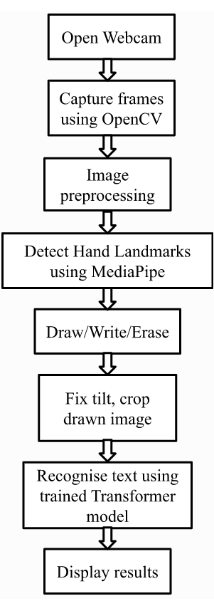
METHODOLOGY
The application consists of 2 parts:
Recognizing Hand-gestures to draw content.
Parsing content to text.
Use OpenCV and Mediapipe to process live video and identify index finger position.
Trace the movement of the finger onto a canvas.
Identify content on canvas, fix rotation, tilt, and crop to content.
Infer text from drawing using the Transformer based model we trained.
Click here

Slide 6
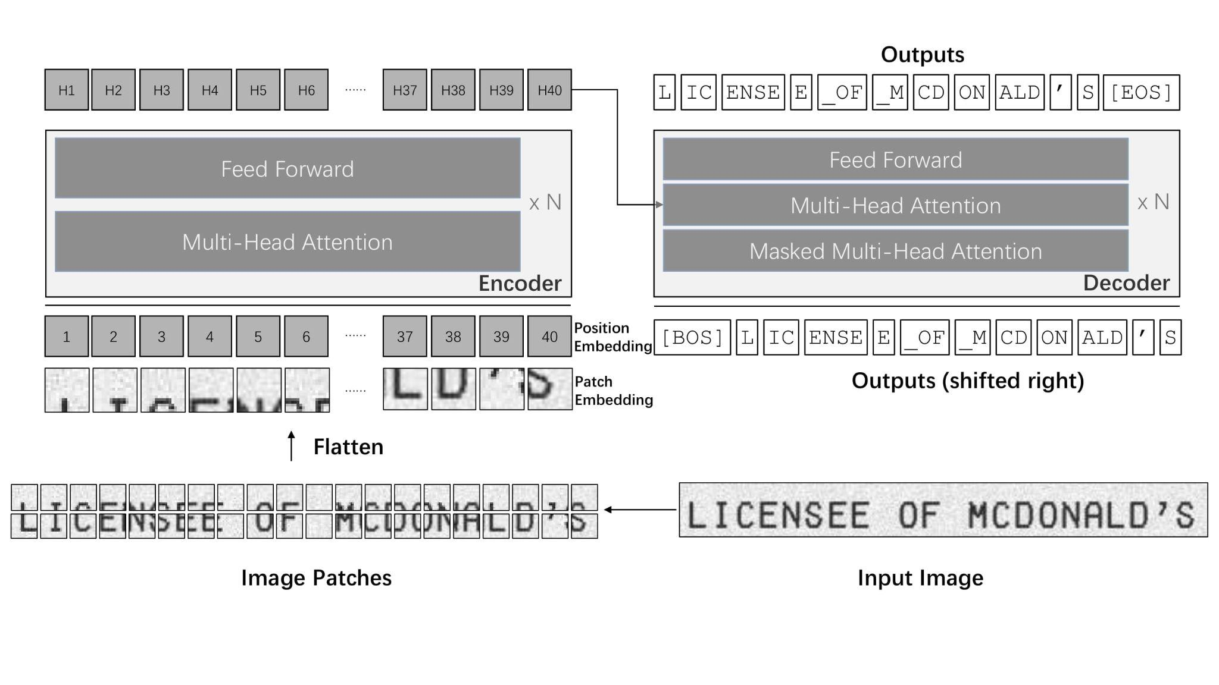
TRANSFORMER BASED-OPTICAL CHARACTER RECOGNITION (TrOCR)
The encoder obtains the representation of the image patches.
The decoder generates the wordpiece sequence with the guidance of the visual features and previous predictions.
No image-specific inductive biases and process the image as a sequence of patches.
Makes it easier to pay different attention to the whole image or the independent patches. (multi-head attention)

Slide 7

EXPERIMENTS WITH TRANSFORMER MODEL
Utilized pre-trained TrOCR model trained on document and scene levels.
Focused on word or character-level data due to canvas size limitation.
Evaluated Character Error Rate (CER) on word-level IAM dataset.
Trained on word-level IAM dataset.
Handwriting in digital form looks different to an ML model due to jagged edges and lines.
Created custom dataset, of over 480 images.
Trained model on custom dataset, saw significant improvement in CER
Improve using larger dataset.
Improve generalization to different writing styles

Slide 8
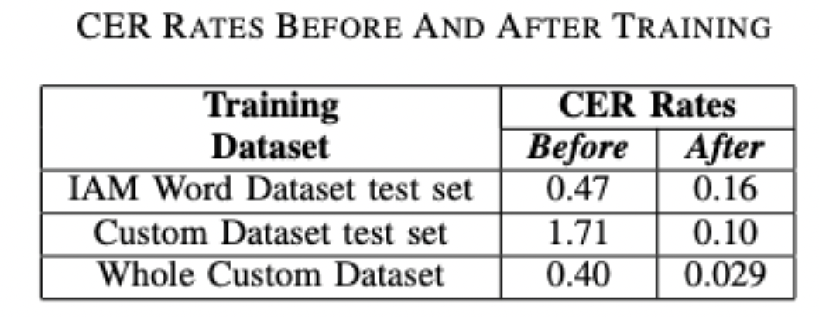
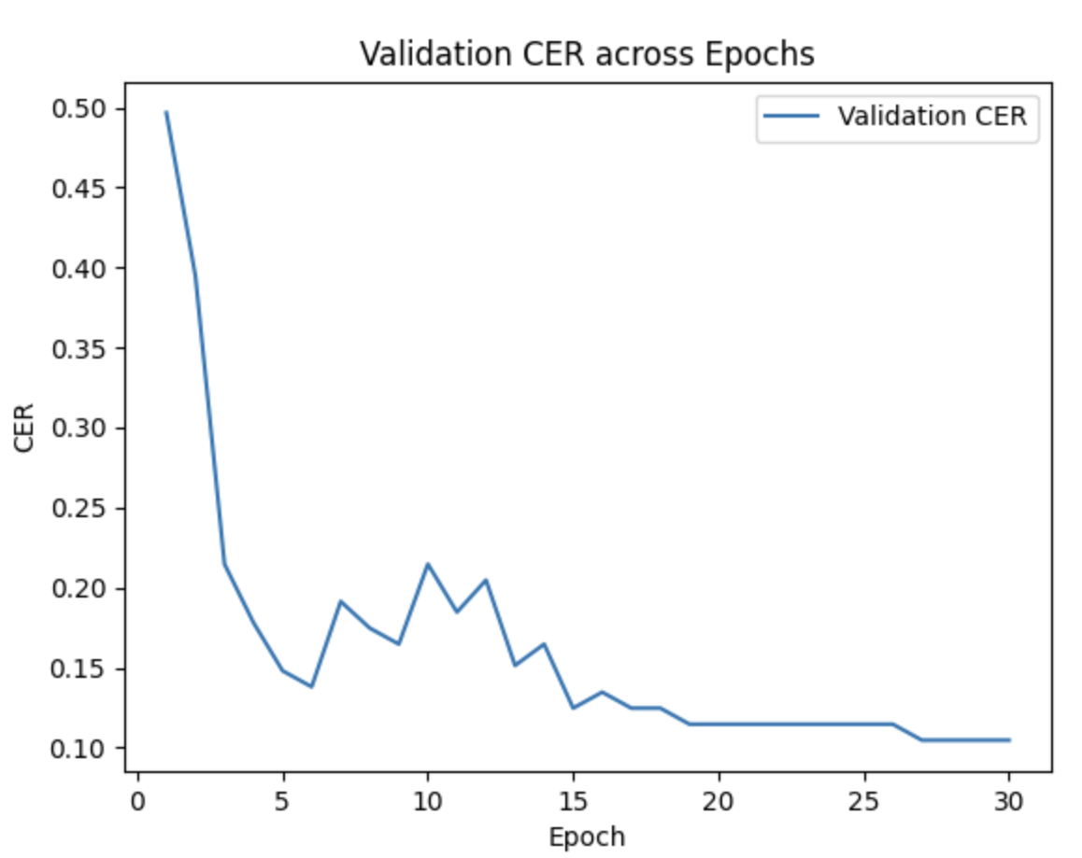
RESULTS
The CER performance of word-level recognition was bad initially.
After tweaking with the word data, the performance improved for words.
However, the recognition performance for digital writing was not good.
Therefore, we created a custom dataset for of digitally drawn text.
Trained the model on it and the CER was better than before

Slide 9
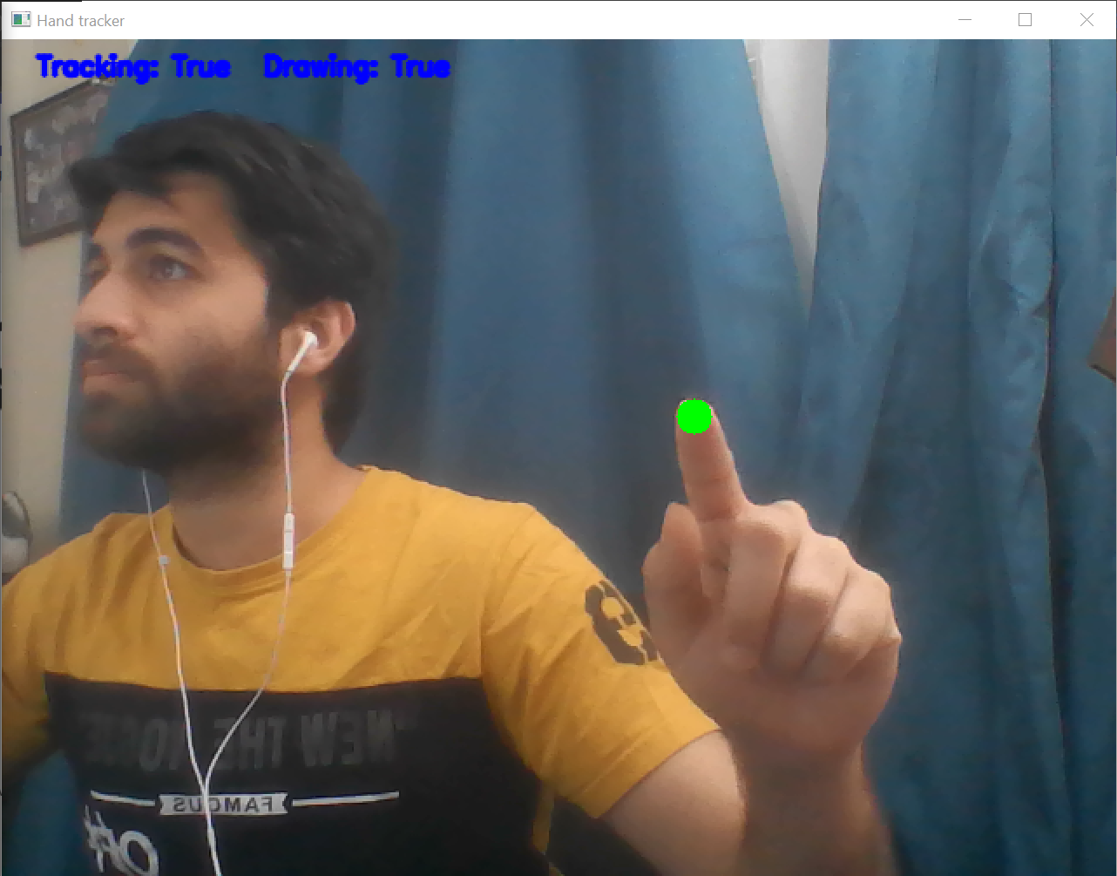
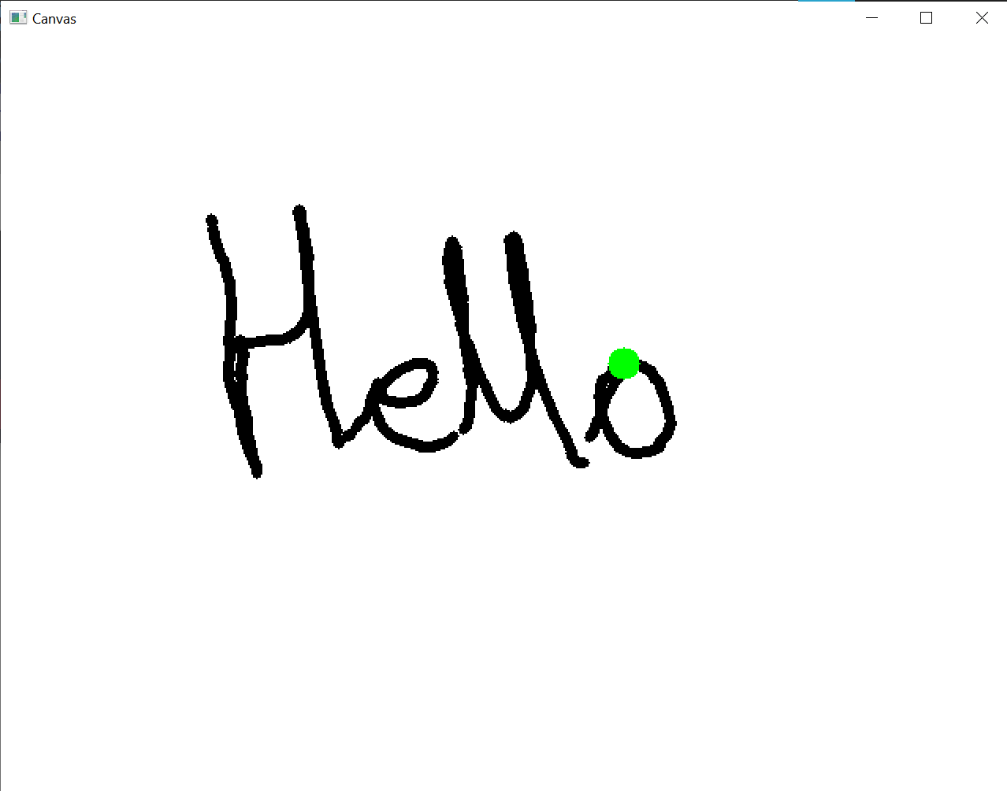
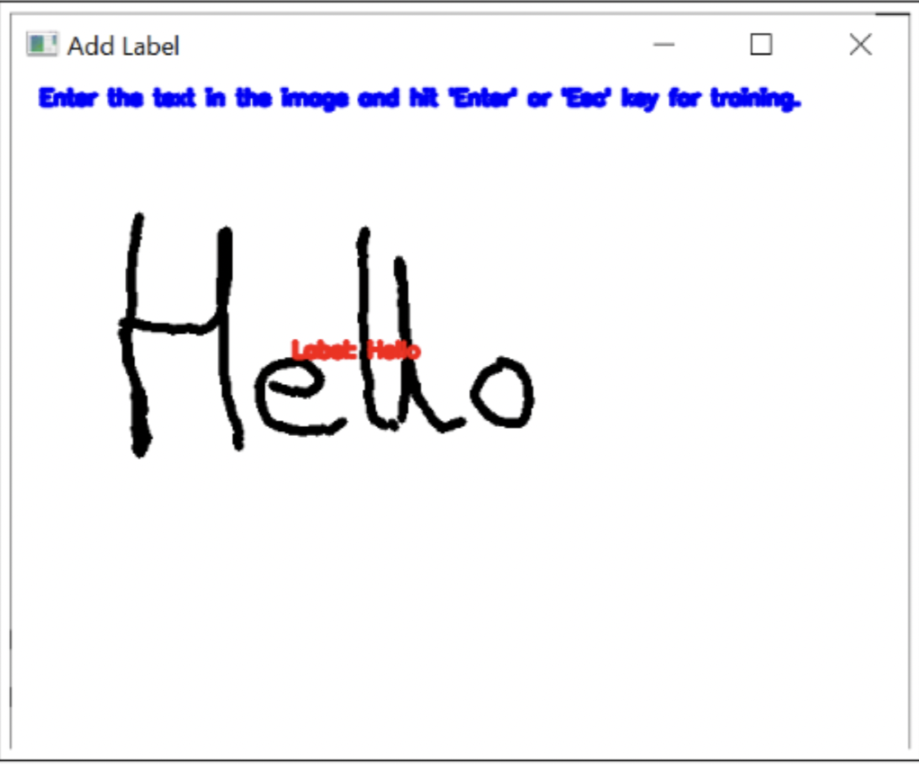
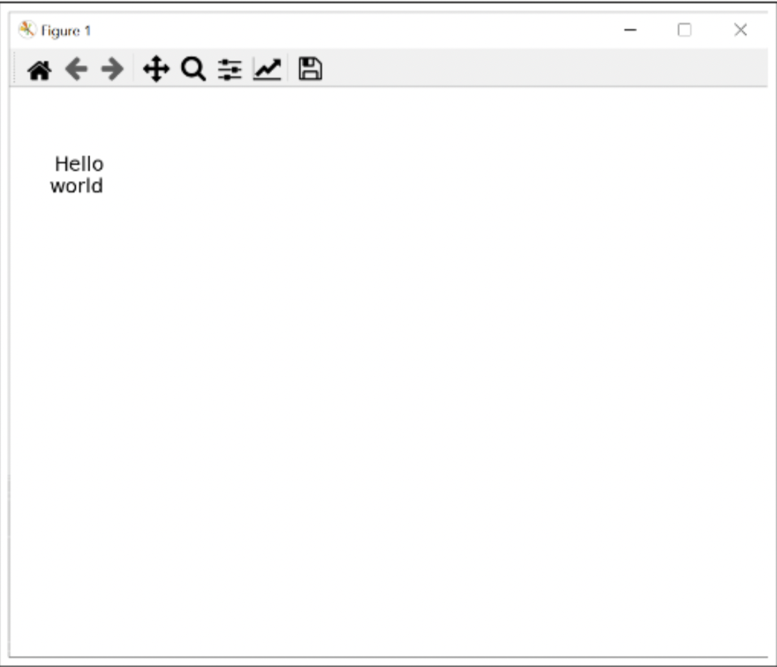
APPLICATION

Slide 10

CONCLUSION
The results of our experiments showed that the system was able to achieve good accuracy in recognizing handwritten text and gestures.
The use of a pre-trained model, fine-tuned with IAM word dataset and our custom dataset, helped to improve the performance of the system significantly.
This project has demonstrated the feasibility and effectiveness of using machine learning and deep learning techniques for handwriting gesture detection and recognition and we believe that this research area will continue to grow in importance in the coming years.
Applications for this project include Accessibility for people with disabilities, Signature verification, Text recognition in document scanning and digitization and Smart whiteboards.

